Slide 1

Model representation
Linear regression with one variable
Machine Learning
Slides from CS-229 by Andrew Ng

Slide 2
Housing Prices
220
Price
(in 1000s of dollars)
1250
Size (feet²)
Supervised Learning
Given the “right answer” for each example in the data.
Regression Problem
Predict real-valued output
Classification : Discrete-valued output (e.g., car, chair, table, etc.)

Slide 3
Training set of
housing prices
(Portland, OR)
Size in feet² (x) | Price ($) in 1000's (y)
2104 | 460
1416 | 232
1534 | 315
852 | 178
… | …
m
Notation:
m = Number of training examples
x’s = “input” variable / features
y’s = “output” variable / “target” variable
x⁽¹⁾ = 2104
y⁽¹⁾ = 460
x⁽²⁾ = 1416
y⁽²⁾ = 232
(x, y) – one training example
(x^{(i)}, y^{(i)}) – ith training example

Slide 4
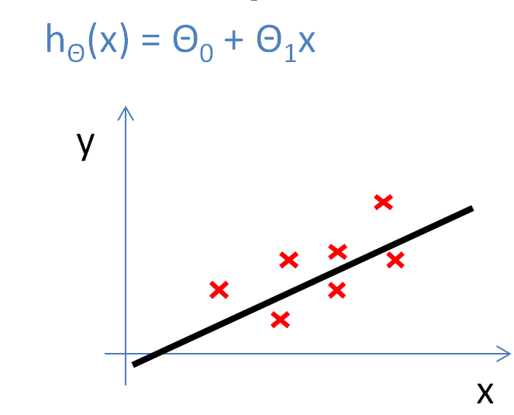
Training Set
How do we represent h ?
Learning Algorithm
Size of house
h
Estimated price
x
hypothesis
Estimated
value (y)
Linear regression with one variable.
Univariate linear regression.
h maps from x’s to y’s
One variable

Slide 5
Cost function
Linear regression with one variable
Machine Learning

Slide 6
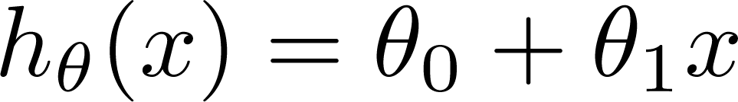

Training Set
Size in feet² (x) | Price ($) in 1000's (y)
2104 | 460
1416 | 232
1534 | 315
852 | 178
… | …
Hypothesis:
‘s: Parameters
How to choose ‘s ?

Slide 7
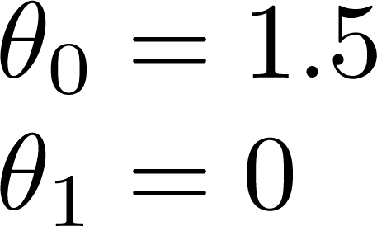
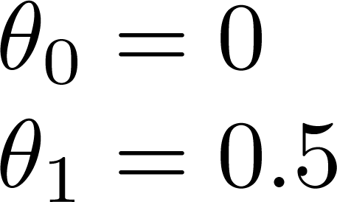
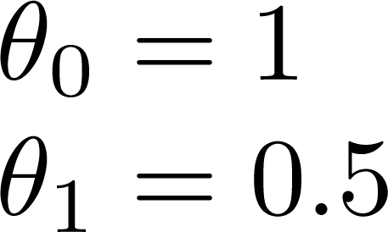
h(x) = 1.5 + 0·x
h(x) = 0.5·x
h(x) = 1 + 0.5·x

Slide 8
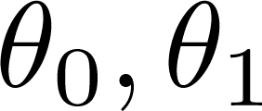
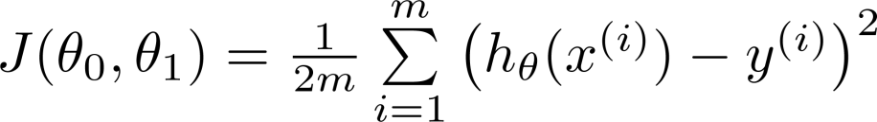


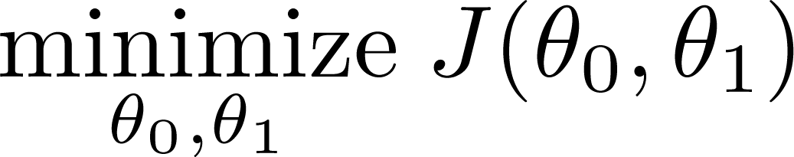
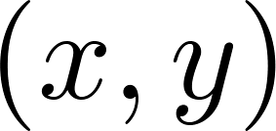

Hypothesis:
(x^{(i)}, y^{(i)})
y
Parameters:
$$\text{Θ}\text{0, }\text{Θ}\text{1}$$
x
Cost Function:
Idea: Choose so that is close to for our training examples
Squared error function
Goal:

Slide 9
Cost function intuition
Linear regression with one variable
Machine Learning

Slide 10
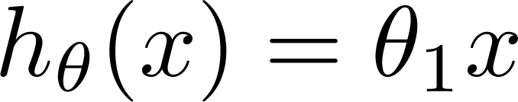

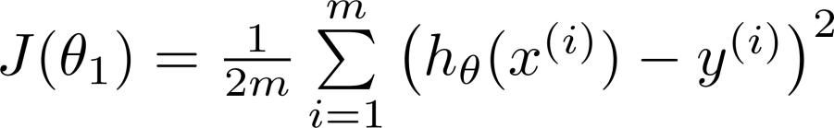
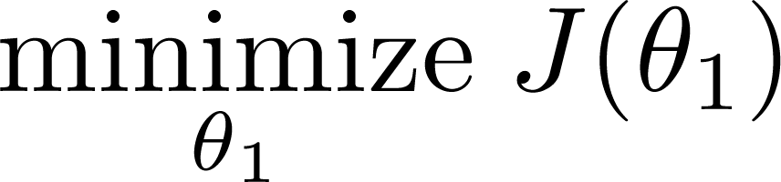

Simplified
Hypothesis:
Parameters:
h(x)
$\text{Θ}\text{0}$ = 0
h(x)
Cost Function:
Goal:

Slide 11






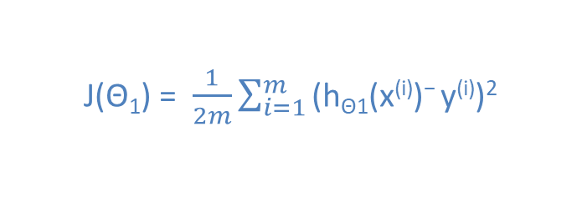


(for fixed , this is a function of x)
(function of the parameter )
y
x
J($\text{Θ}\text{1}$) = $\frac{1}{2m}\sum_{i=1}^{m}{\text{(}\text{h}\text{Θ}\text{1}\text{(}\text{x}\text{(}\text{i}\text{))− }\text{y}\text{(}\text{i}\text{))2}}$
= $\frac{1}{2m}\left(02+02+02\right)$
$$J\left(1\right)=0$$

Slide 12

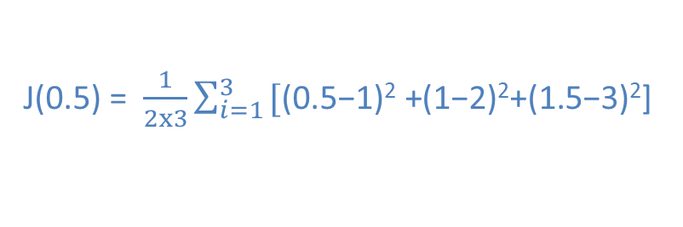



(for fixed , this is a function of x)
(function of the parameter )
y
$$\text{y}\text{(}\text{i}\text{)}$$
$$\text{h}\text{Θ}\text{(}\text{x}\text{(}\text{i}\text{))}$$
x
J($\text{0.5}$) = $\frac{1}{2x3}\sum_{i=1}^{3}{\text{[}\text{(0.5−1)}\text{2} \text{+}\text{(}\text{1−2}\text{)}\text{2}\text{+(1}\text{.5−3}\text{)}\text{2}\text{]} }$
= $\frac{1}{6}$(3.5) = 0.58

Slide 13

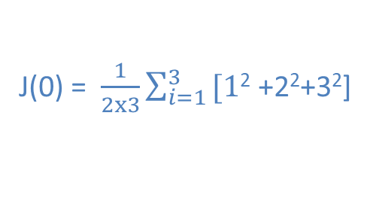

(for fixed , this is a function of x)
(function of the parameter )
y
Convex function (bowl shape)
x
J($\text{0}$) = $\frac{1}{2x3}\sum_{i=1}^{3}{\text{[1}\text{2} \text{+2}\text{2}\text{+}\text{3}\text{2}\text{]} }$
= $\frac{1}{6}∙14$ = 2.3

Slide 14
Next: Gradient Descent
A way to minimize cost function.

